Slide 1









SALES DECK

Slide 2




CONCEPT TIDE
AI-Powered, Human-Integrated Innovation Platform
We provide an AI-powered, human-integrated insights platform that seamlessly connects product concept generation and validation into a unified solution. This enables brands to identify market gaps, develop solutions rooted in real consumer needs, and confidently predict product success

Slide 3







CONCEPT GENERATOR
Category & Market Context
Category Pain Point Analysis
Trend Alignment & Solution Mapping
Provides insights into the top 15 brands and three most important Needs State they occupy
Provide insight into problem areas, size of impacted audience
Delivers Insights into category trends mapped to consumer pain points

Slide 4
CONCEPT GENERATOR
Opportunity Sizing & Prioritization
Competitive Congestion & Opportunity Mapping
Concept
Generator
Provides an estimate of the size of opportunity space
Determines which brands occupy key need spaces and where opportunities exist.
Generates new and differentiating concepts solving real consumer problems

Slide 5
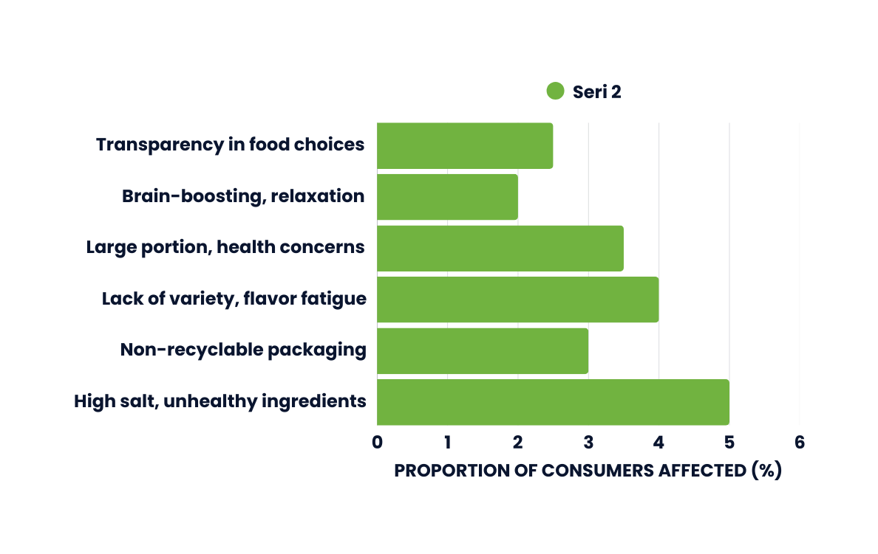
DEFINE CONSUMERS’ PAIN POINTS
Identify category tensions grounded in real consumer problems/pain points that could drive incremental growth for your brand.
Unpack the problem area to uncover who is affected the most, proportion of consumers affected, the functional and emotional needs being impacted, and select the most strategic problem to solve
Proportion Consumers Affected (%)
Needs State Affected
Physical Wellbeing
Restoration
Weight Management
Taste & indulgence
Energise
Refreshment
Convenience
Social Connection

Slide 6


The Right Solution
Find the Right Solution to Fix the Problem
Anchor your solution(s) on proven emerging approaches used to solve similar problems in adjacent categories.
Cross-reference problem area, needs state and category shifts to define strategic innovation pathways designed to tackle problems and drive incremental growth
Needs State | Consumer Pain Points | Trending Solution
Health & Wellness | High Salt, unhealthy ingredients | Low-salt, natura, gut-health promoting ingredients
Sustainability | Non-recyclable packaging | Sustainable Packaging
Taste & Indulgence | Lack of variety, flavor fatigue | Exotic Flavors
Convenience | Large portion sizes, health concerns | Portion Control Packaging
Mental Wellbeing | Brain-Boosting relaxation | Functional Ingredients
Weight Management | Transparency in food choices, health concerns | Clean Label Products

Slide 7



AGENDA
MAP AND PRIORITISE OPPORTUNITY SPACES
Make data-driven decisions about what opportunity space to target based on a holistic view of the size of the opportunity, market trends evidence, and competitor performance information, to identify relevant marketspaces with growth potential
Consider the size of the opportunity, trend momentum and competitive saturation. In addition, evaluate the stability of emerging solutions and whitespace to determine where to play

Slide 8
AGENDA
Needs State | Trending Solution | Consumer Pain Points | Trend Growth Rate (%) | Proportion of Consumers Affected | Brand Occupancy | Whitespace Score
Health & Wellness | Low-salt, natura, gut-health promoting ingredients | High Salt, unhealthy ingredients | -5.0% | -50% | 5 | 5
Sustainability | Sustainable Packaging | Non-recyclable packaging | -4.5% | -30% | 6 | 2.25
Taste & Indulgence | Exotic Flavors | Lack of variety, flavor fatigue | -4.2% | -40% | 8 | 2.1
Convenience | Portion Control Packaging | Large portion sizes, health concerns | -3.8% | -35% | 9 | 1.9
Mental Wellbeing | Functional Ingredients | Brain-Boosting relaxation | -5.5% | -20% | 2 | 5.5
Weight Management | Clean Label Products | Transparency in food choices, health concerns | -4.8% | -25% | 3 | 4

Slide 9


Generate Winning
Product Concepts
Use our proprietary Concept Generator, powered by meta learnings from validated consumer pain points, category trends and whitespaces, competitive and regulatory intelligence, to produce up to 50 strategic product concepts.
Explore novel ingredients, underutilised sensory attributes, and product formats that differentiate your brand early in development. Increase agility, reduce risk, and open up new growth opportunities by experimenting earlier and smarter.

Slide 10

Generate Winning Product Concepts
Proposed Product Concept: | "Mindful Munchies"
Tagline | "Nourish Your Body and Mind"
Product Description | Mindful Munchies are innovative potato chips crafted to support overall wellness and cognitive health. Made from a blend of nutrient-rich root vegetables and infused with natural nootropic herbs, these chips offer a delicious way to fuel both body and mind.
Key Features:
Root Vegetable Base: | Combining sweet potatoes, beets, and parsnips for a rich source of vitamins, minerals, and antioxidants.
Infused with Nootropic Herbs: | Incorporating ingredients like Ashwagandha and Rhodiola Rosea, known for their stress-reducing and cognitive-enhancing properties.
Natural Seasonings: | Using herbs and spices such as rosemary and turmeric to enhance flavour and provide additional health benefits.
Cooked in Avocado Oil: | Offering healthy monounsaturated fats and a subtle, smooth taste.
Free from Artificial Additives: | No artificial flavours, colours, or preservatives.
Ingredients: | Ingredients: Sweet potatoes, beets, parsnips, Ashwagandha extract, Rhodiola Rosea extract, Sea salt, rosemary, turmeric, black pepper, Avocado oil.

Slide 11
Generate Winning Product Concepts
Sensory Profile: | Sensory Profile:
Appearance: (Pack Design) | Vibrant mix of colours from the assorted root vegetables, lightly dusted with visible herbs and spices. Inviting scent combining earthy root vegetables with aromatic herbs.
Aroma: | Inviting scent combining earthy root vegetables with aromatic herbs.
Texture: | Crispy and light, with a satisfying crunch.
Flavour: | A harmonious blend of natural sweetness from root vegetables, balanced with savoury herbs and a hint of spice.
Infused with Nootropic Herbs: | Incorporating ingredients like Ashwagandha and Rhodiola Rosea, known for their stress-reducing and cognitive-enhancing properties.
Natural Seasonings: | Using herbs and spices such as rosemary and turmeric to enhance flavour and provide additional health benefits.
Cooked in Avocado Oil: | Offering healthy monounsaturated fats and a subtle, smooth taste.
Free from Artificial Additives: | No artificial flavours, colours, or preservatives.
Ingredients: | Ingredients: Sweet potatoes, beets, parsnips, Ashwagandha extract, Rhodiola Rosea extract, Sea salt, rosemary, turmeric, black pepper, Avocado oil.

Slide 12

CONCEPT SCREENING – PRIORITISE HIGH-IMPACT INNOVATION
Identify and prioritize product concepts with the highest potential for market success
Leverage ConceptTide, our proprietary AI-powered and human-integrated screening tool, to rapidly evaluate multiple concepts, accelerate speed to market, and confidently minimize risk
ConceptTide is the only solution on the market, that evaluates product ideas across critical performance dimensions: Market trends alignment, competitive performance benchmarking, ingredient risk and compliance and formulation versatility and cross-usage potential
Key Metrics: Predictive Market Success Potential, Market Trend Alignment, Competitive Performance Score and Concept Versatility & Use-Case Fit.

Slide 13
Concept Screening – Prioritize High-Impact Innovation
Needs State | Test 1 | Test 2 | Test 3 | Test 4 | Test 5
Market Success Potential (%) | 65.80% | 71.00% | 79.10% | 85.20% | 77.50%
Purch Intent | 62.9% |  | 78.6% |  | 78.8%
Market Trend Alignment | 56% | 56% | 84% | 84% | 60%
Competitive Benchmarking | 61.8% | 77.8% | 86.4% | 83% | 79.4%
Versatility & Use-Case Fit | 73% | 80% | 86.4% | 82.6% | 83.20%
Sensory appeal/taste | 74.4% | 78% | 85.6% | 85.6% | 84%

Slide 14
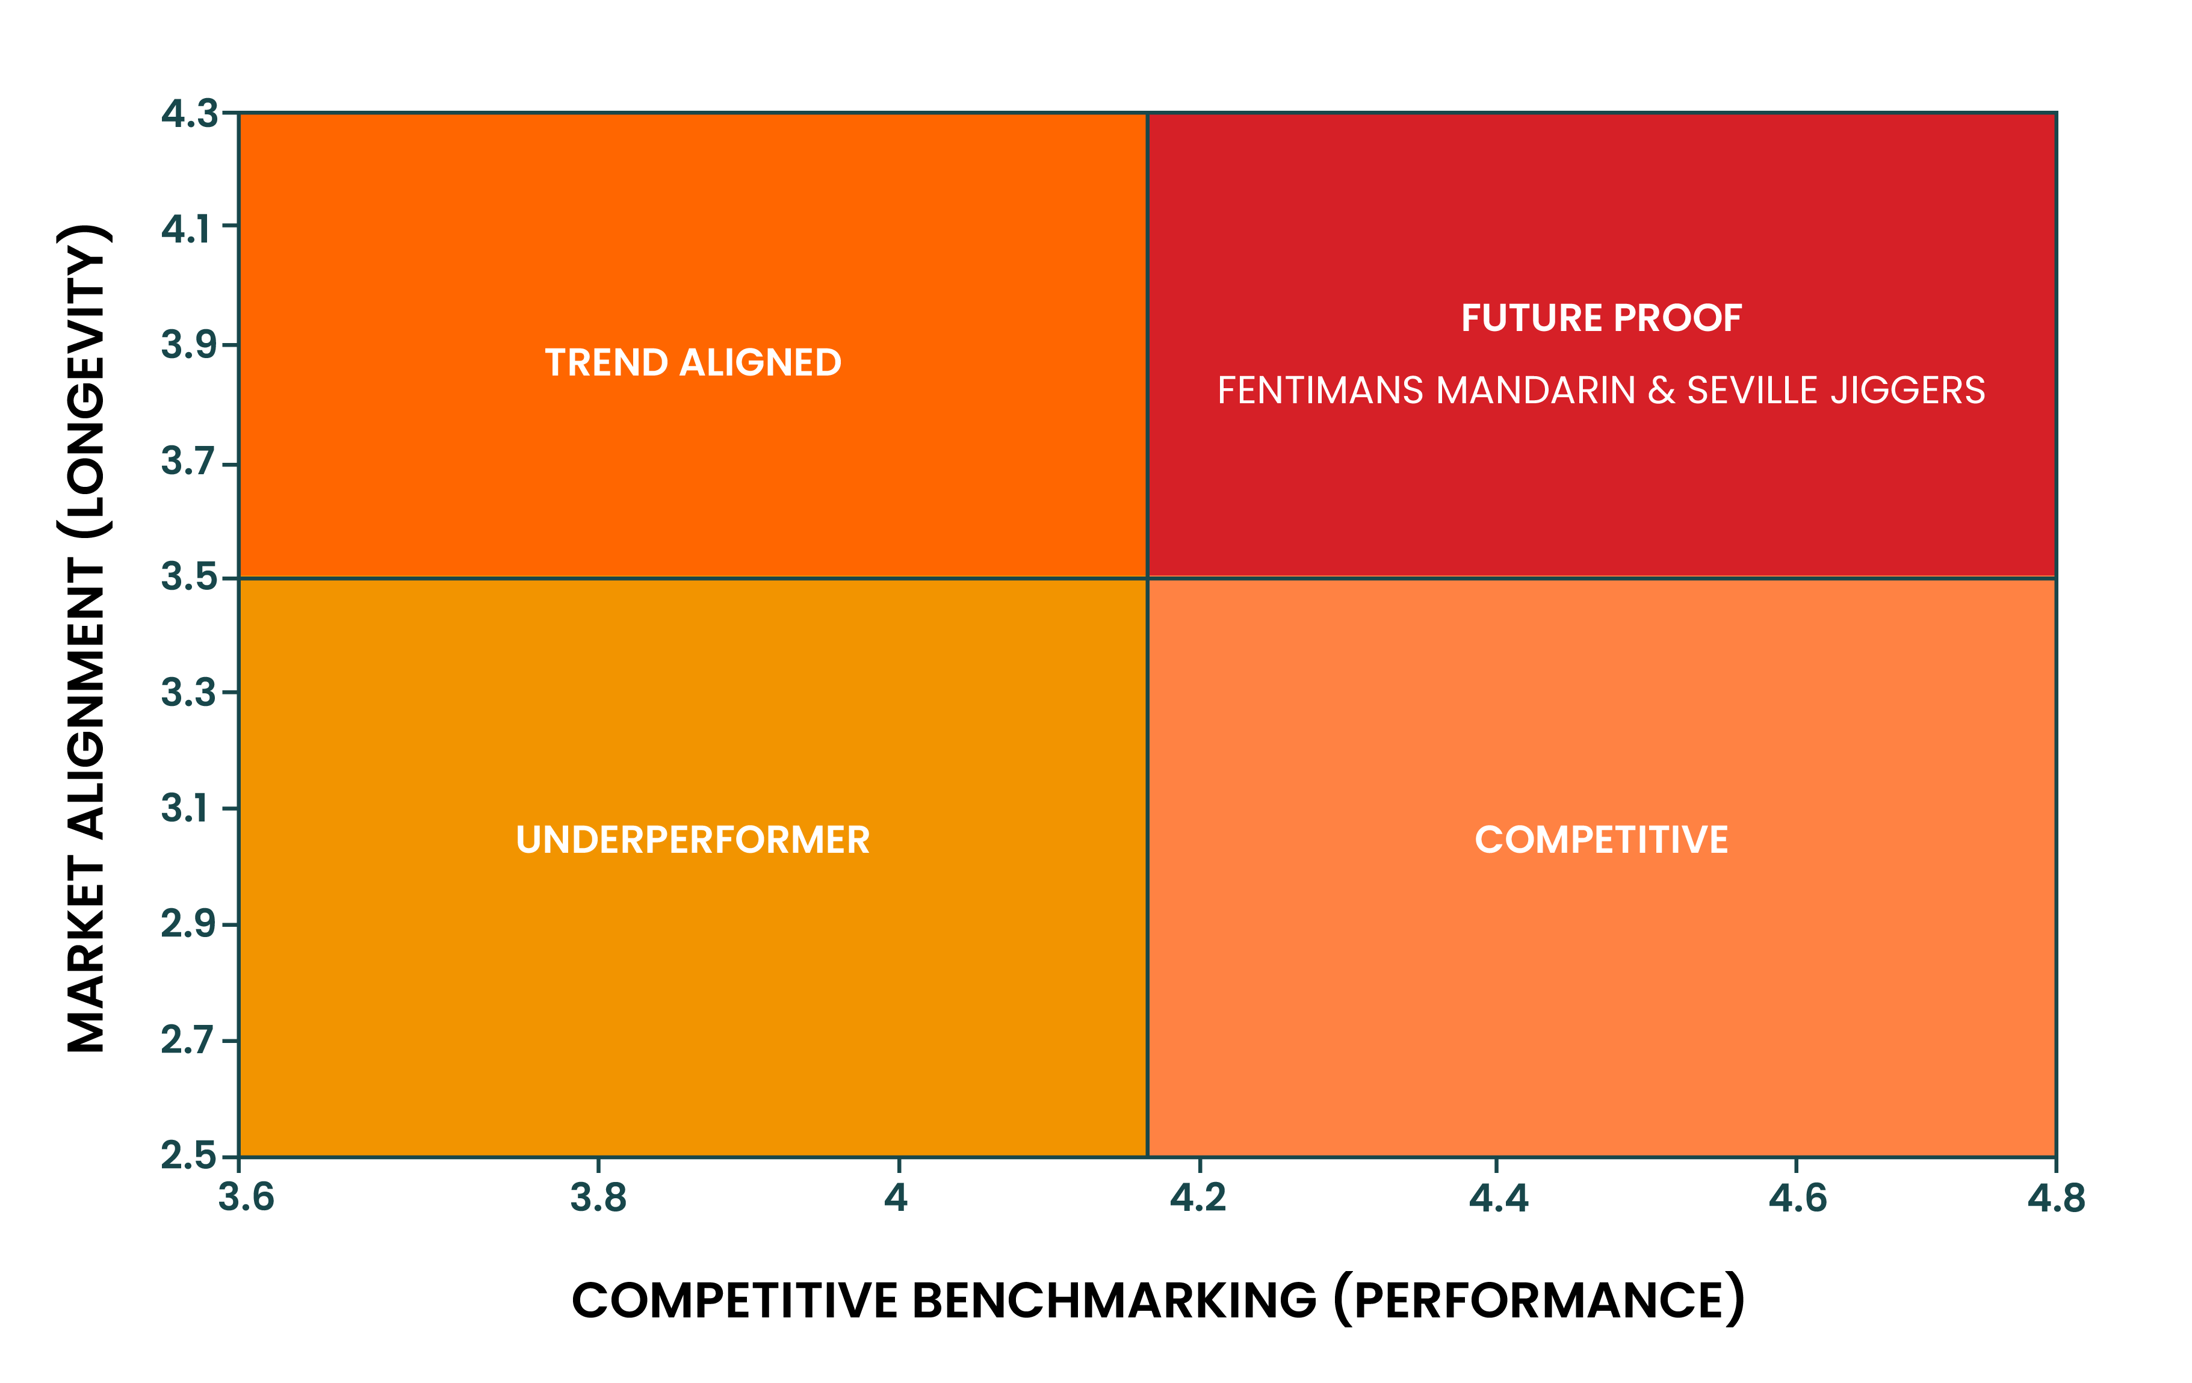
Focus on Long-Term Growth
AGENDA
Longevity – Performance Matrix
Make data-driven innovation decisions based on a balanced view of short-term viability and long-term relevance.
Cross-reference trend trajectory with competitor performance to pinpoint resilient, high-growth concepts. Prioritize ideas that align with both consumer evolution and strategic brand positioning.

Slide 15
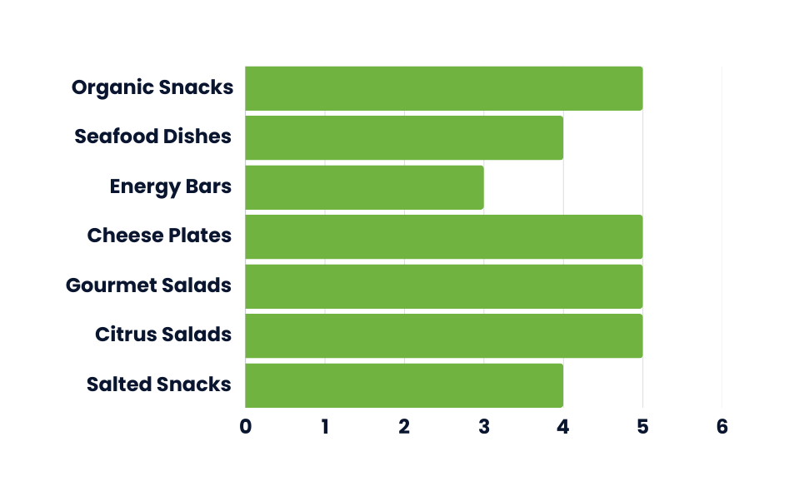
Target Growth-Driving Concepts
Filter concepts based on their ability to serve multiple usage occasions and drive volume through versatility and high usage frequency.
Explore product pairing scenarios to enhance category stretch and drive incremental penetration.

Slide 16
Ensure Ingredient Integrity
AGENDA
Ingredient | Risk Level | Safety Concerns | Alternative Suggestions
Carbonated Water | Low | None | N/A
Blood Orange Juice | Low | Contributes to natural sugar intake | N/A
Sugar | Moderate | High sugar intake risks | Natural sweeteners (e.g., stevia, honey)
Citric Acid | Low | Dental erosion with excessive consumption | N/A
Evaluate the risk and safety of proposed ingredients using global regulatory benchmarks (FDA, WHO, EFSA).
Identify red-flag ingredients
Discover safer, trend-aligned alternatives

Slide 17





Thank You!
Contact
David Lansanah
Phone
+44 (0) 796 055 4413
Email
David.lansanah@Concettide.com

